Slide 1
One hidden layer
Neural Network
Backpropagation
intuition (Optional)
Notes:
Lets use computatiok graph to understand how did we arrive at the equations.

Slide 2





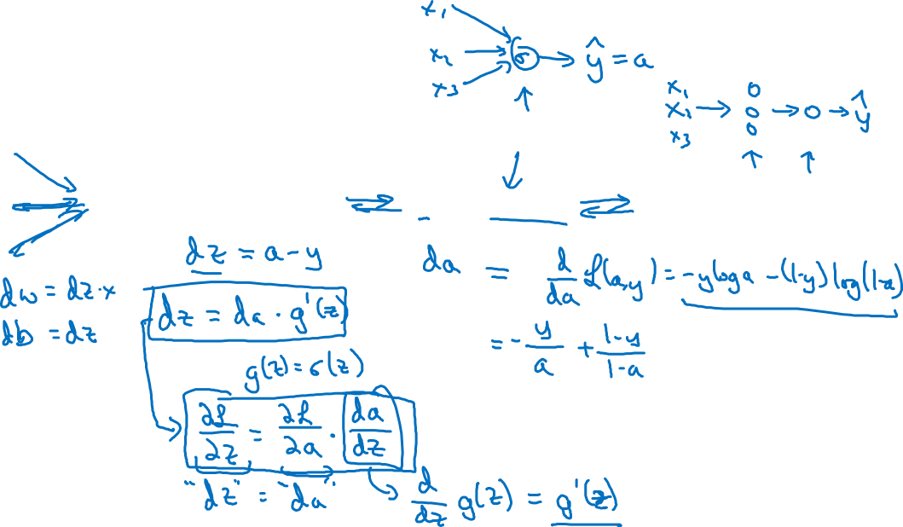

Computing gradients
Logistic regression
$$x$$
$$w$$
$$z=w^{T}x+b$$
$$a= σ(z)$$
$$ℒ(a,y)$$
$$b$$
Notes:
da means derivative of loss function wrt to a. Dz means derivative of loss function wrt to z. Using chain rule, we can compute the value of dz. If we take derivative of a wrt to z it will give us dz/da & we already have da/dl. Now to compute the dz/dl we can use this formula & compute using dz/dl = dz/da. Da/dl
In this slide, da means da/dl & the thing that is multiplying with it is g prime z which is derivative of a wrt to z hence we have just replace it with g prime.
We can propagate the dz backwards & we just multiply this with the weights & sum for the bias.
This was for logistic regression where we have only one step without any middle layer. In case of neural network we have a middle layer therefore this propagation needs to be done accordingly.

Slide 3
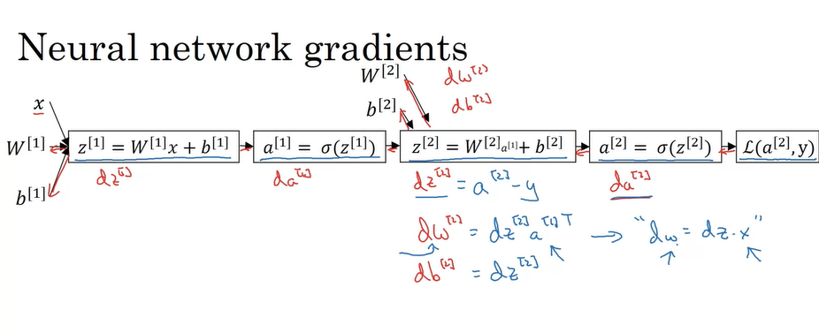
Dz2,dw2, db2
Notes:
In forward propagation we first compute z1 , than we compute a1, than we compute z2 & than a2, which gives you the loss.
In backward propagation, we first compute da2 i.e. da/dl & using it we compute dz/dl, which we use to compute dw2 & db2. Similarly we follow backwards.
We don’t take derivatives wrt to x at least in supervised learning.
In practice, we can skip computing da/dl & can directly compute dz/dl because this is what we are interested in since it gives us ability to updated our weights & biases.
Dz2/dl = a2 – y , dw2 = dz2 a1 transpose, this step is similar to logistic regression except the step of transpose.
The relationship between our original matrix w & individual w there was a transpose there. Let me explain this concept in the below point.
We have a weight matrix W for all the weights when we are moving from one layer to the other. In this matrix, the weights are arranged such that each row represents the weights associated with one node in the next layer. This is what we mean that there was a transposed relationship between them. This is why when we are computing dw2 using dz2 we take transpose of a1 matrix. A1 is playing the role of x, the reason that we have taken transpose is that we want to apply dz2 to the input now the input for this is a1 which was calculated
A

Slide 4
Dz1 part
Notes:
The formula for dz1 is W2 transpose, dz2 * derivative of (z1). This derivative is shown as g prime. & the * shows element wise multiplication.

Slide 5


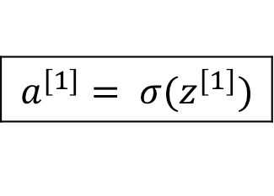

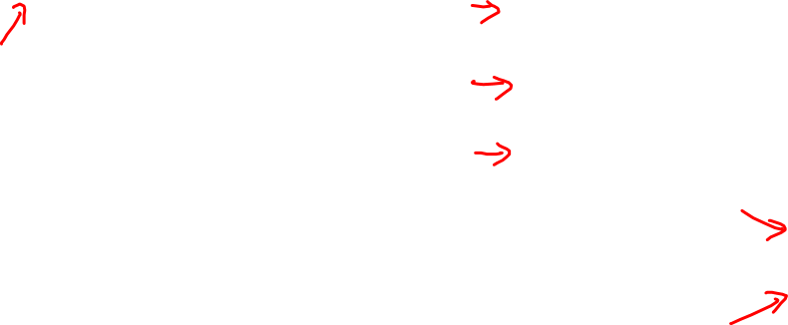



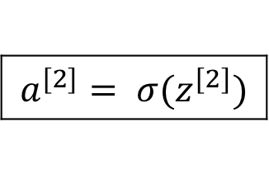


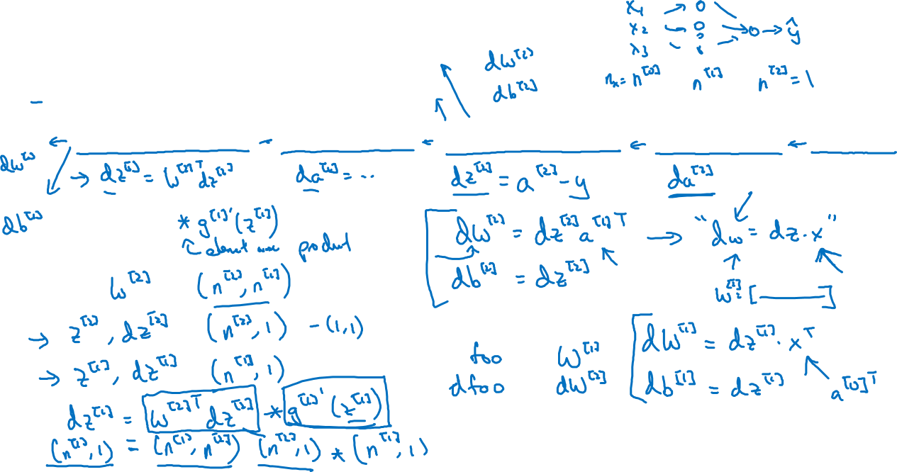
Neural network gradients
$$W^{[2]}$$
$$x$$
$$b^{[2]}$$
$$W^{[1]}$$
$$z^{[1]}=W^{[1]}x+b^{[1]}$$
$$a^{[1]}= σ(z^{[1]})$$
$$z^{[2]}=W^{[2]}x+b^{[2]}$$
$$a^{[2]}= σ(z^{[2]})$$
$$ℒ(a^{[2]},y)$$
$$b^{[1]}$$
Notes:
If you just make sure that the dimensions are working correctly, than I will already eliminate a lot of bugs.

Slide 6





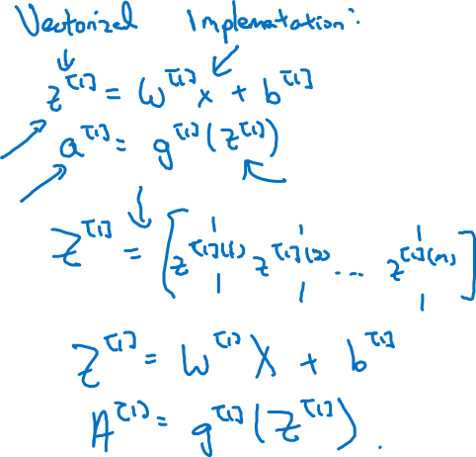
Summary of gradient descent
$$dz^{[2]}=a^{[2]}−y$$
$$dW^{[2]}=dz^{[2]}a^{{\left[1\right]}^{T}}$$
$$db^{[2]}=dz^{[2]}$$
$$dz^{[1]}=W^{\left[2\right]T}dz^{[2]}∗g^{[1]}′(z^{\left[1\right]})$$
$$dW^{[1]}=dz^{[1]}x^{T}$$
$$db^{[1]}=dz^{[1]}$$

Slide 7

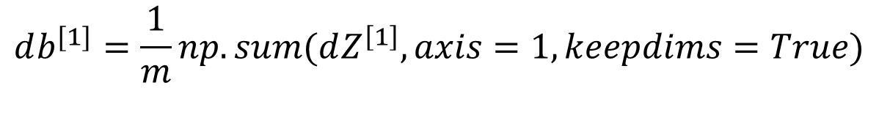
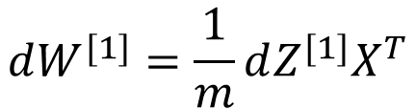
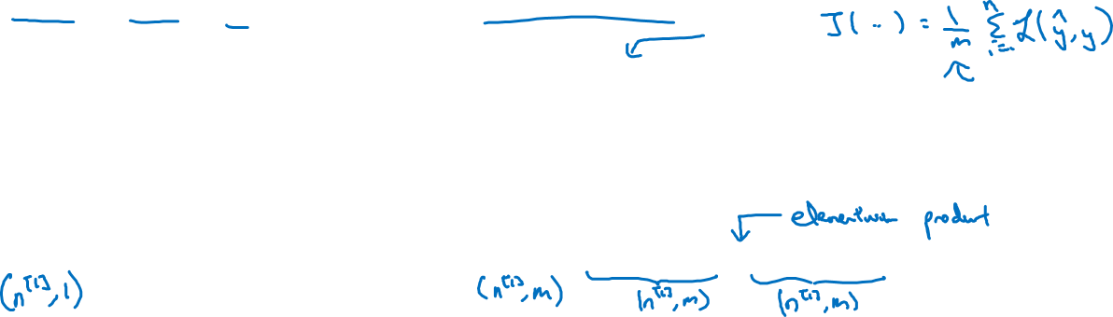
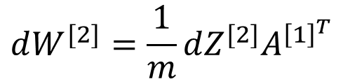
Summary of gradient descent
$$dz^{[2]}=a^{[2]}−y$$
$$dZ^{[2]}=A^{[2]}−Y$$
$$dW^{[2]}=dz^{[2]}a^{{\left[1\right]}^{T}}$$
$$dW^{[2]}=\frac{1}{m}dZ^{[2]}A^{{\left[1\right]}^{T}}$$
$$db^{[2]}=dz^{[2]}$$
$$db^{[2]}=\frac{1}{m}np.sum(dZ^{\left[2\right]},axis=1, keepdims=True)$$
$$dz^{[1]}=W^{\left[2\right]T}dz^{[2]}∗g^{[1]}′(z^{\left[1\right]})$$
$$dZ^{[1]}=W^{\left[2\right]T}dZ^{[2]}∗g^{[1]}′(Z^{\left[1\right]})$$
$$dW^{[1]}=dz^{[1]}x^{T}$$
$$dW^{[1]}=\frac{1}{m}dZ^{[1]}X^{T}$$
$$db^{[1]}=dz^{[1]}$$
$$db^{[1]}=\frac{1}{m}np.sum(dZ^{\left[1\right]},axis=1, keepdims=True)$$

